Slide 1
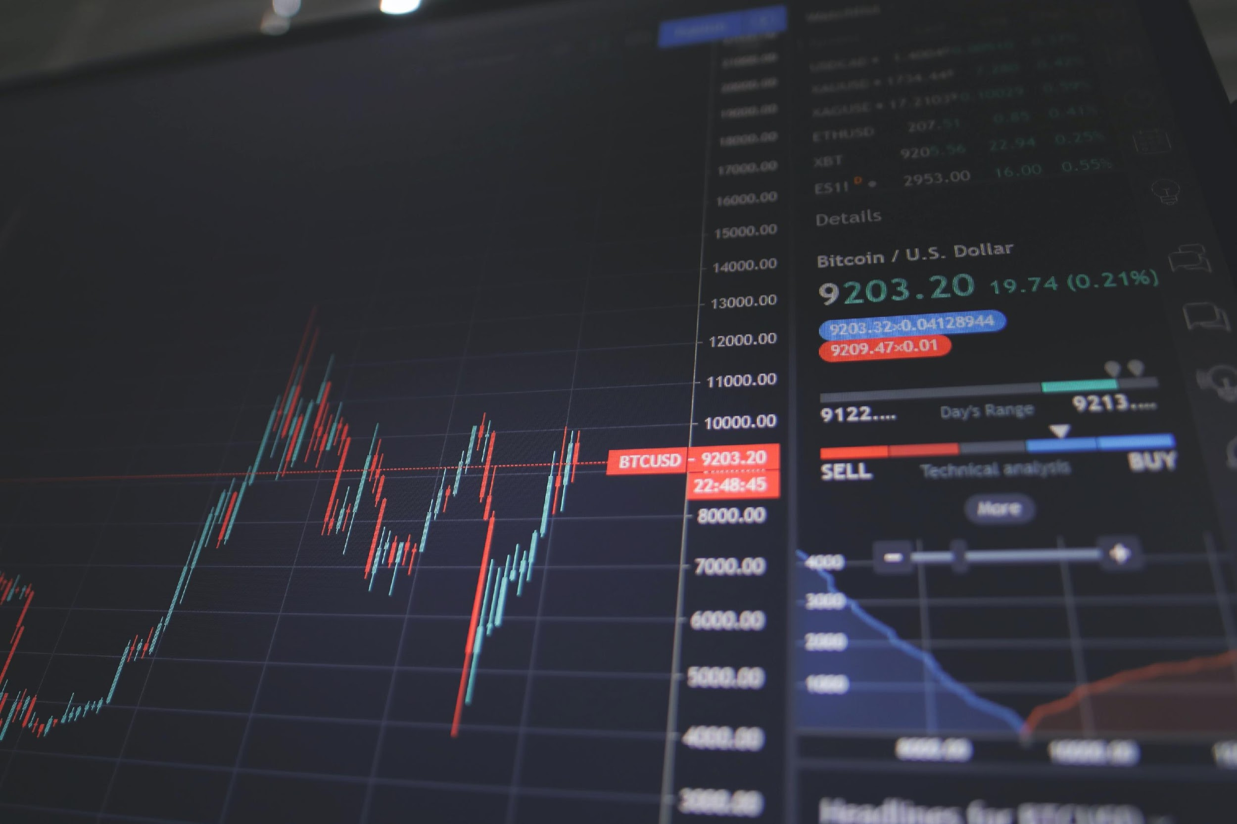

Stock Market Prediction
Major Project
(PW761CS)
Team Guide: Asst. Prof. Mohd Abdul Raheem
Team members:
SYED AHMED RAFAE 1604-17-733-020
SYED OSMAN HUSSAIN 1604-17-733-030
MOHD SHAKEEB 1604-17-733-036

Slide 2

Contents
Introduction
Objective
Research
Requirements
Implementation
Future Works
References

Slide 3
Abstract
Stock market data is a time-series data in which stock value varies depends on time. Prediction of the stock market is an endeavour to assess the future value of a company’s stock rate which will increase the investor’s proﬁt. The proposed system predicts the stock price of any company mentioned by the user for the next few days. Using the predicted stock price and datasets collected from various sources regarding certain equity, the overall sentiment of the stock is predicted.

Slide 4
Introduction
The stock prices are volatile in nature and are hard to predict them. The market price movement changes due to various reasons and the sentiment of the market depend on the current issues and decision was taken not only by a single person but also a lot more who invest their money in this. All the people who invest in the market should be able to decide where to invest their money. Predicting time series data to forecast stock prices is one of the applications of machine learning techniques.

Slide 5
Problem Statement
Because of usefulness and needs from the people, opinion mining became an active research area.
As the volume of the opinionated data increases, analyzing and summarizing opinionated data is becoming more important. To satisfy these needs, many kinds of opinion summarization techniques are proposed.

Slide 6
Objective
To make a reliable prediction tool that is better and more accurate than the ones the market provides
To make a simple UI/UX that makes it easy for non-programmers to use the tool

Slide 7
Literature survey
Roondiwala, Murtaza, H. Patel and Shraddha Varma. “Predicting Stock Prices Using LSTM.” (2017).
Kannan, Sekar, Sathik and P. Arumugam in used data mining technology to discover the hidden patterns from the historic data that have probable predictive capability in their investment decisions.
The prediction of stock market is challenging task of financial time series predictions.
There are five Methods namely Typical price(TP),Bollinger bands, Relative strength index (RSI), CMI and MA used to analyzed the stock index.

Slide 8
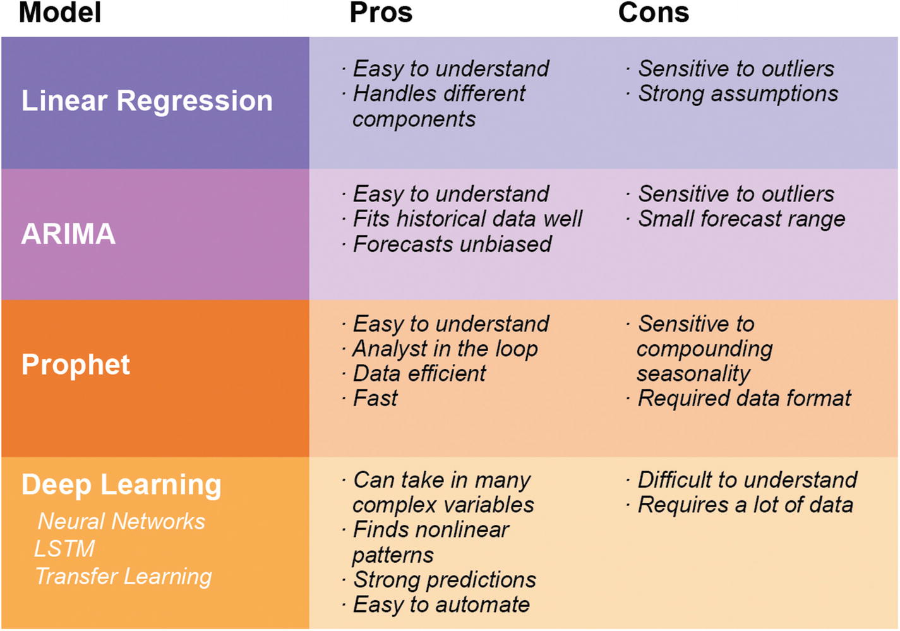
Methods for prediction

Slide 9
LSTM
Long-Short-Term Memory Recurrent Neural Network belongs to the family of deep learning algorithms. It is a recurrent network because of the feedback connections in its architecture. It has an advantage over traditional neural networks due to its capability to process the entire sequence of data.
LSTMs are very powerful in sequence prediction problems because they’re able to store past information. This is important in our case because the previous price of a stock is crucial in predicting its future price.
LSTM Networks are popularly used on time-series data for classification, processing, and making predictions. The reason for its popularity in time-series application is that there can be several lags of unknown duration between important events in a time series.

Slide 11
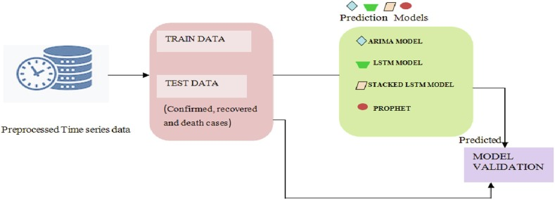
Approach

Slide 12
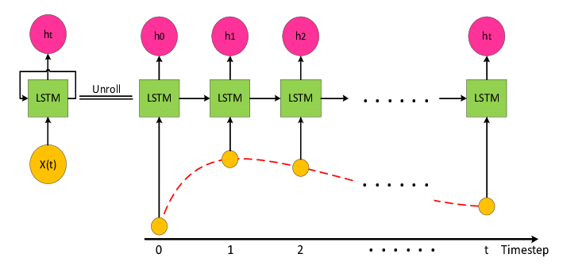
System Architecture

Slide 13
Algorithm
Import
Read the dataset
Analyze the closing prices from dataframe
Sort the dataset on date time and filter “Date” and “Close” columns
Normalize the new filtered dataset
Build and train the LSTM model
Take a sample of a dataset to make stock price predictions using the LSTM model
Save the model
Visualize the predicted stock costs with actual stock costs

Slide 14
Requirements
Minimum Hardware Requirements
Minimum Software Requirements

Slide 15
Minimum Software Requirements
Programming Language: Python
Tools & Libraries: matplotlib, Plotly Dash, pandas datareader, keras
IDE: Visual Studio Code
User Interface: Plotly Dash (for visualization)
Prerequisites: Python, Machine Learning, Deep Learning, Neural Networks

Slide 16
Minimum Hardware Requirements
ROM: 30 GB Hard Disk
RAM: 8+ GB
Processor: i5+
I/O Devices: Keyboard, Mouse, Laptop.

Slide 17
Steps
Run Stock_pred_live_Apple.py
Run Stock_pred_live_Tesla.py
Run Stock_pred_live_Microsoft.py
Run Stock_pred_live_Facebook.py
It creates h5 files with models stored in each which will be used by Stock_app_live.py
Run Stock_app_live.py
Open link from terminal which is a locally hosted site. That is your target.

Slide 18
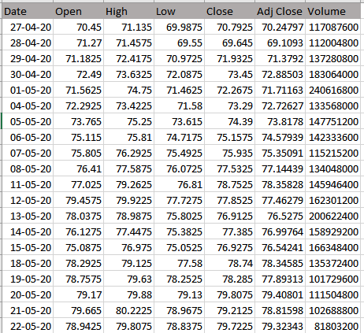
Dataset

Slide 19
Datasets
Used datasets of Apple, Microsoft, Tesla and Facebook.
Used data of 5 years (2016-2021)
80 percent data used to train and 20 percent to test.
Used Yahoo finance to get the accurate data with the help of pandas data-reader library of python

Slide 20
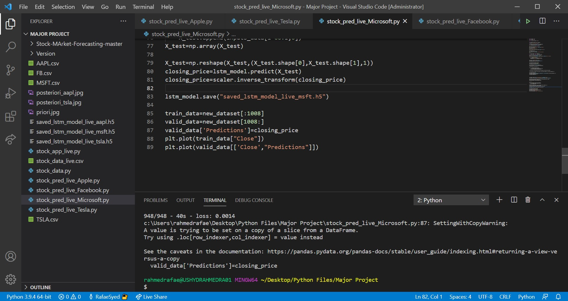
Microsoft Stock Prediction

Slide 21
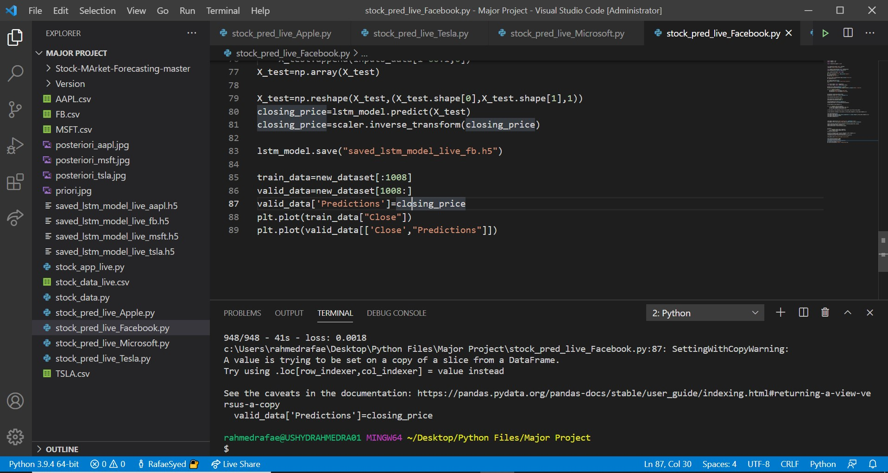
Facebook Stock Prediction

Slide 22
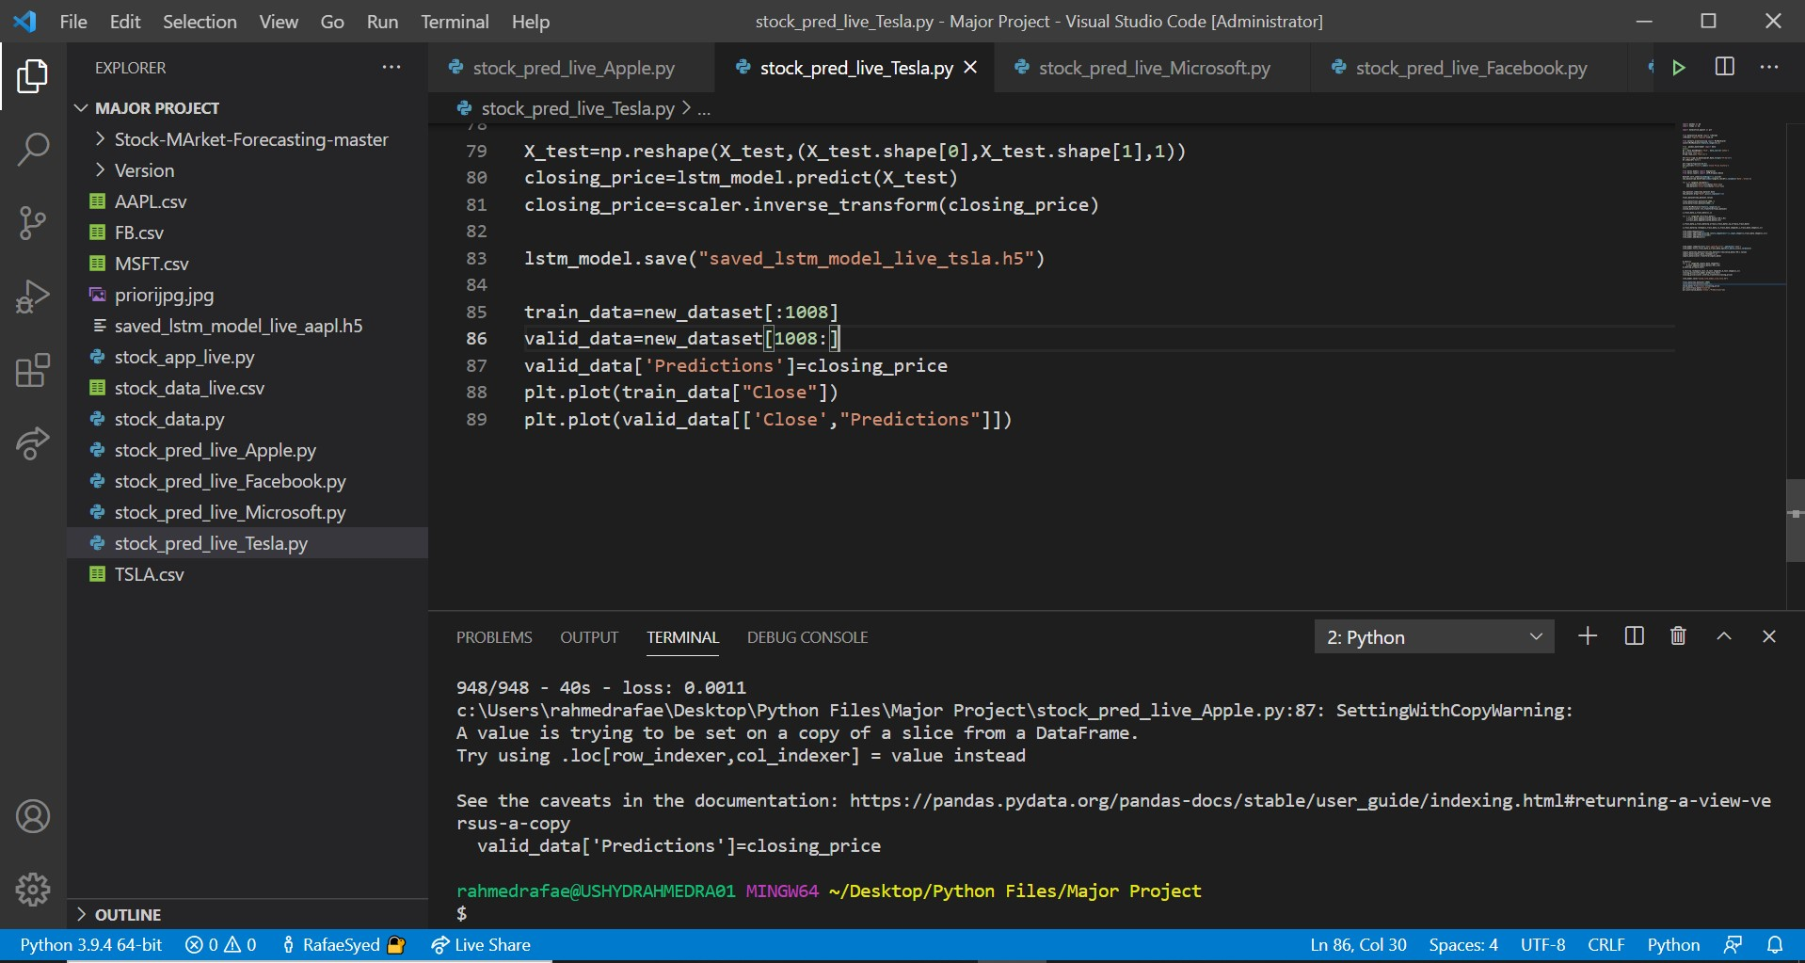
Apple Stock Prediction

Slide 23
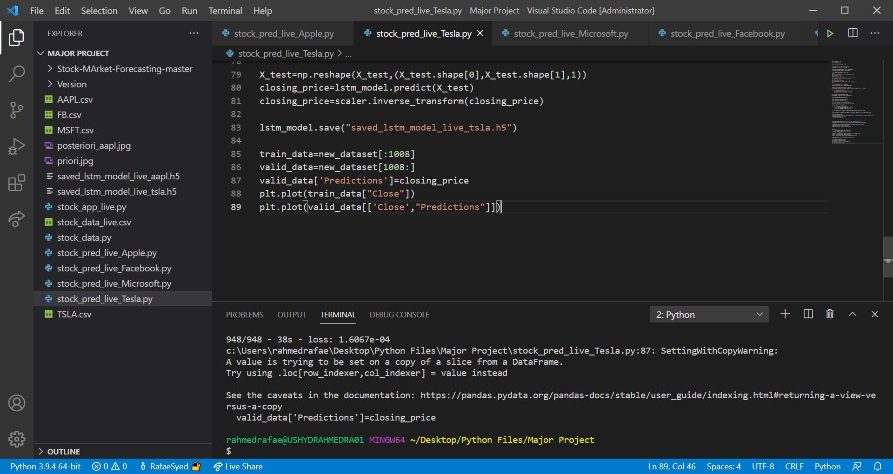
Tesla Stock Prediction

Slide 24
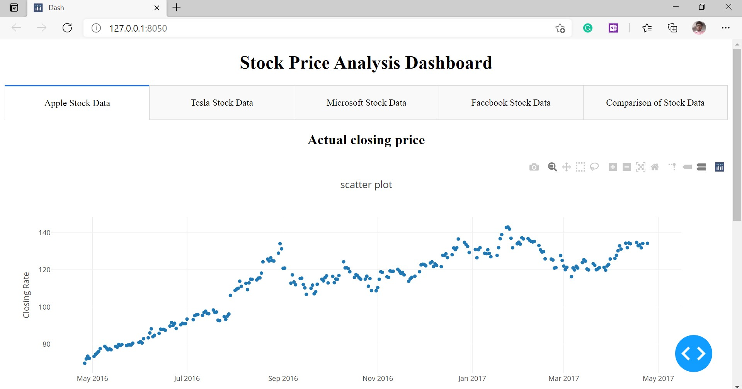

Slide 25
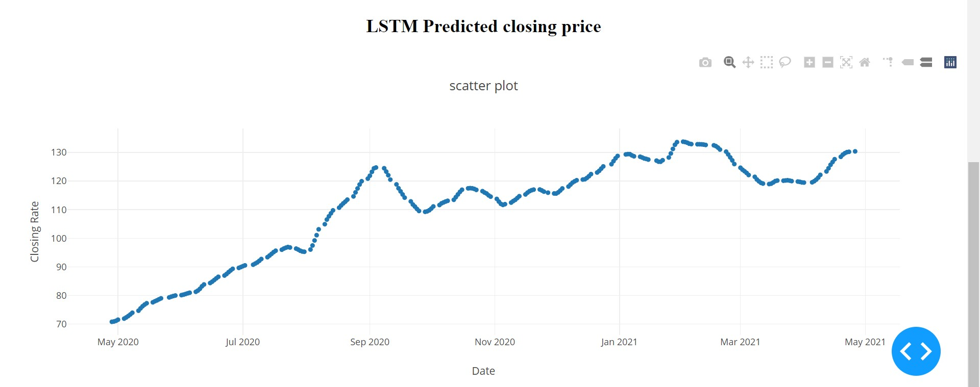

Slide 26
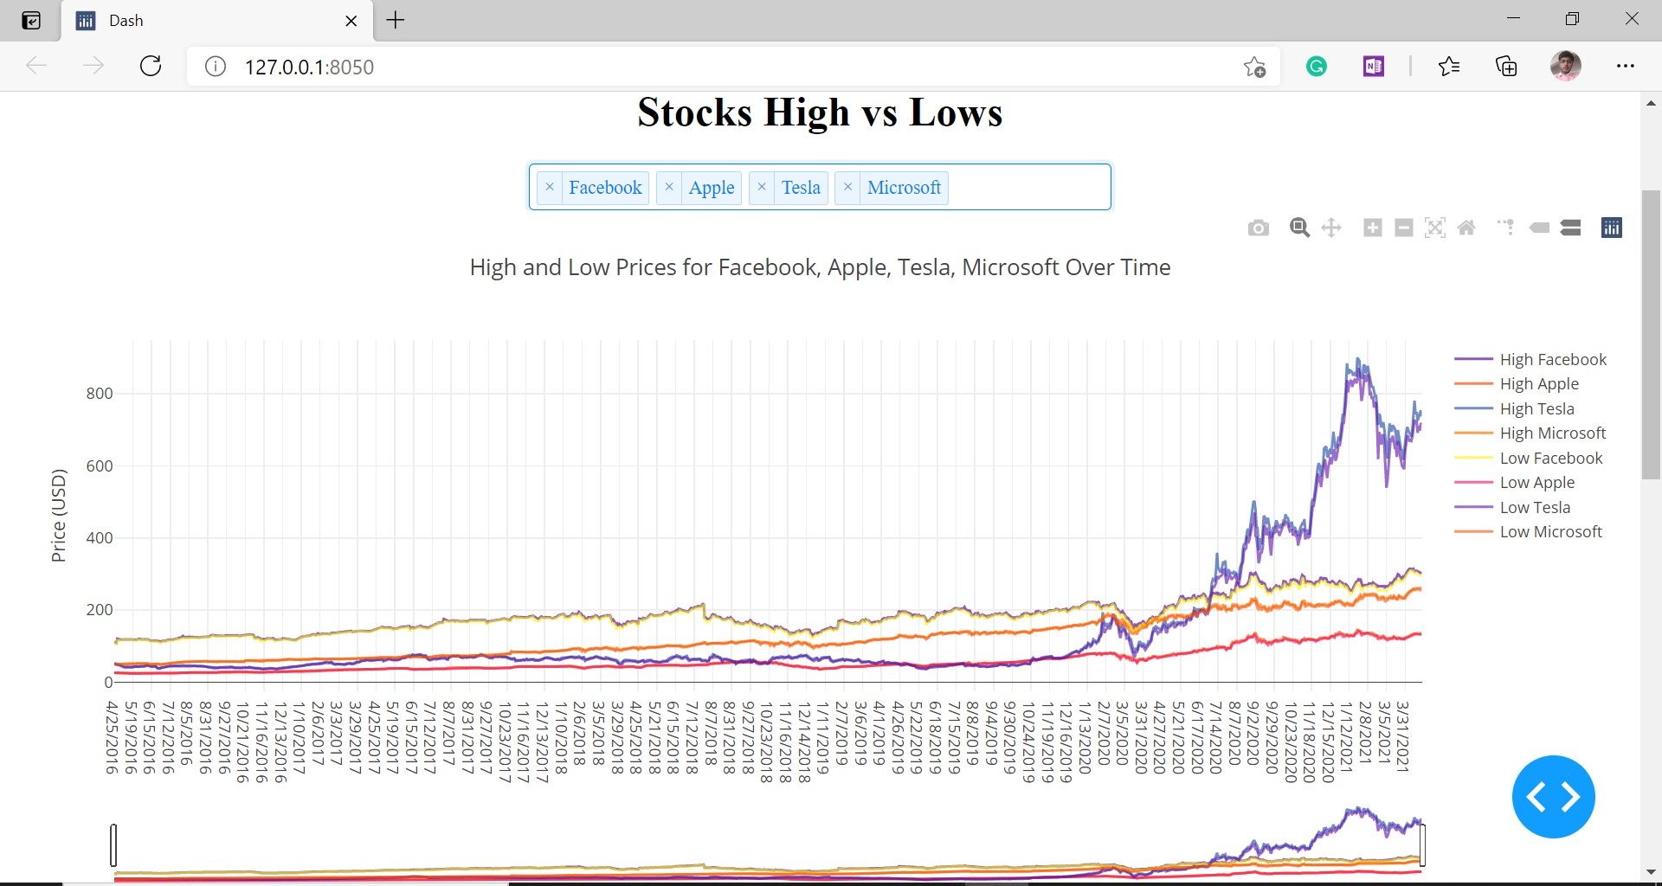
Comparison of Stocks

Slide 27
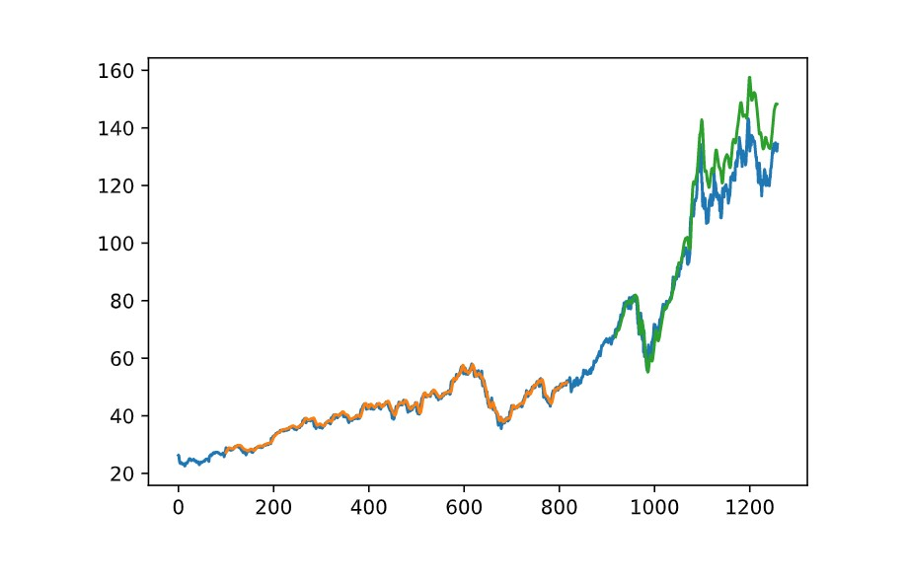
Accuracy measure of Predicted Stock

Slide 28
Conclusion
We implement the application of Artificial Neural Network to the task of stock
market prediction and ANN model and salient feature. Our initial analysis show
significant correlation between different input parameter. The result obtained in
both the cases was fairly accurate. The prediction is fairly accurate unless there is huge and sudden variation in the actual data. On other hand, this also proves the hypothesis that stock market are actually unpredictable.
After the phase of prediction and analysis, the result will be displayed to users in the
form web pages

Slide 29
Future scope of improvement
• Potential improvement can be made to our data collection and analysis method.
• Future research can be done with possible improvement such as more refined data and more accurate algorithm.
• Implementation of discussion forums and economic news portal including other sector apart from hydropower and going in national level.

Slide 30
References
https://www.researchgate.net/publication/331345883_Stock_Market_Prediction_Using_Machine_Learning
https://www.researchgate.net/publication/340874376_Stock_market_analysis_using_candlestick_regression_and_market_trend_prediction_CKRM
M. Usmani, S. H. Adil, K. Raza and S. S. A. Ali, "Stock market prediction using machine learning techniques," 2016 3rd International Conference on Computer and Information Sciences (ICCOINS), Kuala Lumpur, 2016, pp. 322-327.

Slide 31
K. A. Althelaya, E. M. El-Alfy and S. Mohammed, "Evaluation of bidirectional LSTM for short-and long-term stock market prediction," 2018 9th International Conference on Information and Communication Systems (ICICS), 2018, pp. 151-156, doi: 10.1109/IACS.2018.8355458
Forecasting directional movements of stock prices for intraday trading using LSTM and random forests by Pushpendu Ghosh , Ariel Neufeld , Jajati Keshari Sahoo
S. Liu, G. Liao and Y. Ding, "Stock transaction prediction modeling and analysis based on LSTM," 2018 13th IEEE Conference on Industrial Electronics and Applications (ICIEA), 2018, pp. 2787-2790, doi: 10.1109/ICIEA.2018.8398183.
Alex Sherstinsky, Fundamentals of Recurrent Neural Network (RNN) and Long Short-Term Memory (LSTM) network, https://doi.org/10.1016/j.physd.2019.132306.
C. R. Madhuri, M. Chinta and V.V.N.V.P. Kumar, "Stock Market Prediction for Time-series Forecasting using Prophet upon ARIMA," 2020 7th International Conference on Smart Structures and Systems (ICSSS), 2020, pp. 1-5, doi: 10.1109/ICSSS49621.2020.9202042.C. R. Madhuri, M. Chinta and V.V.N.V.P. Kumar, "Stock Market Prediction for Time-series Forecasting using Prophet upon ARIMA,"

Slide 32
Thank You

